Slide 1
Communicating with Data – Storytelling
Dr. Ab Mosca (they/them)
Slides based off slides courtesy of Jordan Crouser (https://jcrouser.github.io/)

Slide 2
Plan for Today
Narrative structures
Storytelling Lab

Slide 3

Storytelling with visualization

Slide 4
storyteller
Discussion
What makes a good story?
audience

Slide 5



Slide 6
Discussion
storyteller
What makes a good story?
point
audience

Slide 7
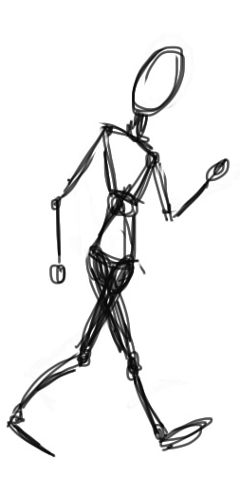


Slide 8
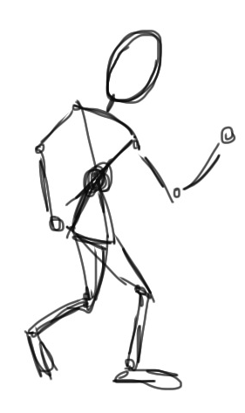

Slide 9
What is that
story about?

Slide 10

What is that
story about?
point

Slide 11
What is that
story about?
point

Slide 12
Ways to get to the point
Climax
of Act 2
Midpoint
(plot twist!)
Crisis
Disaster
Climax
of Act 3
Obstacle
Climax
of Act 1
Obstacle
Obstacle
DESCENDING ACTION
Second
Thoughts
ASCENDING ACTION
Inciting
Incident
Wrap-up
Beginning
End
Act 1
(set up)
Act 2
(confrontation)
Act 3
(resolution)
Three Act Structure

Slide 13
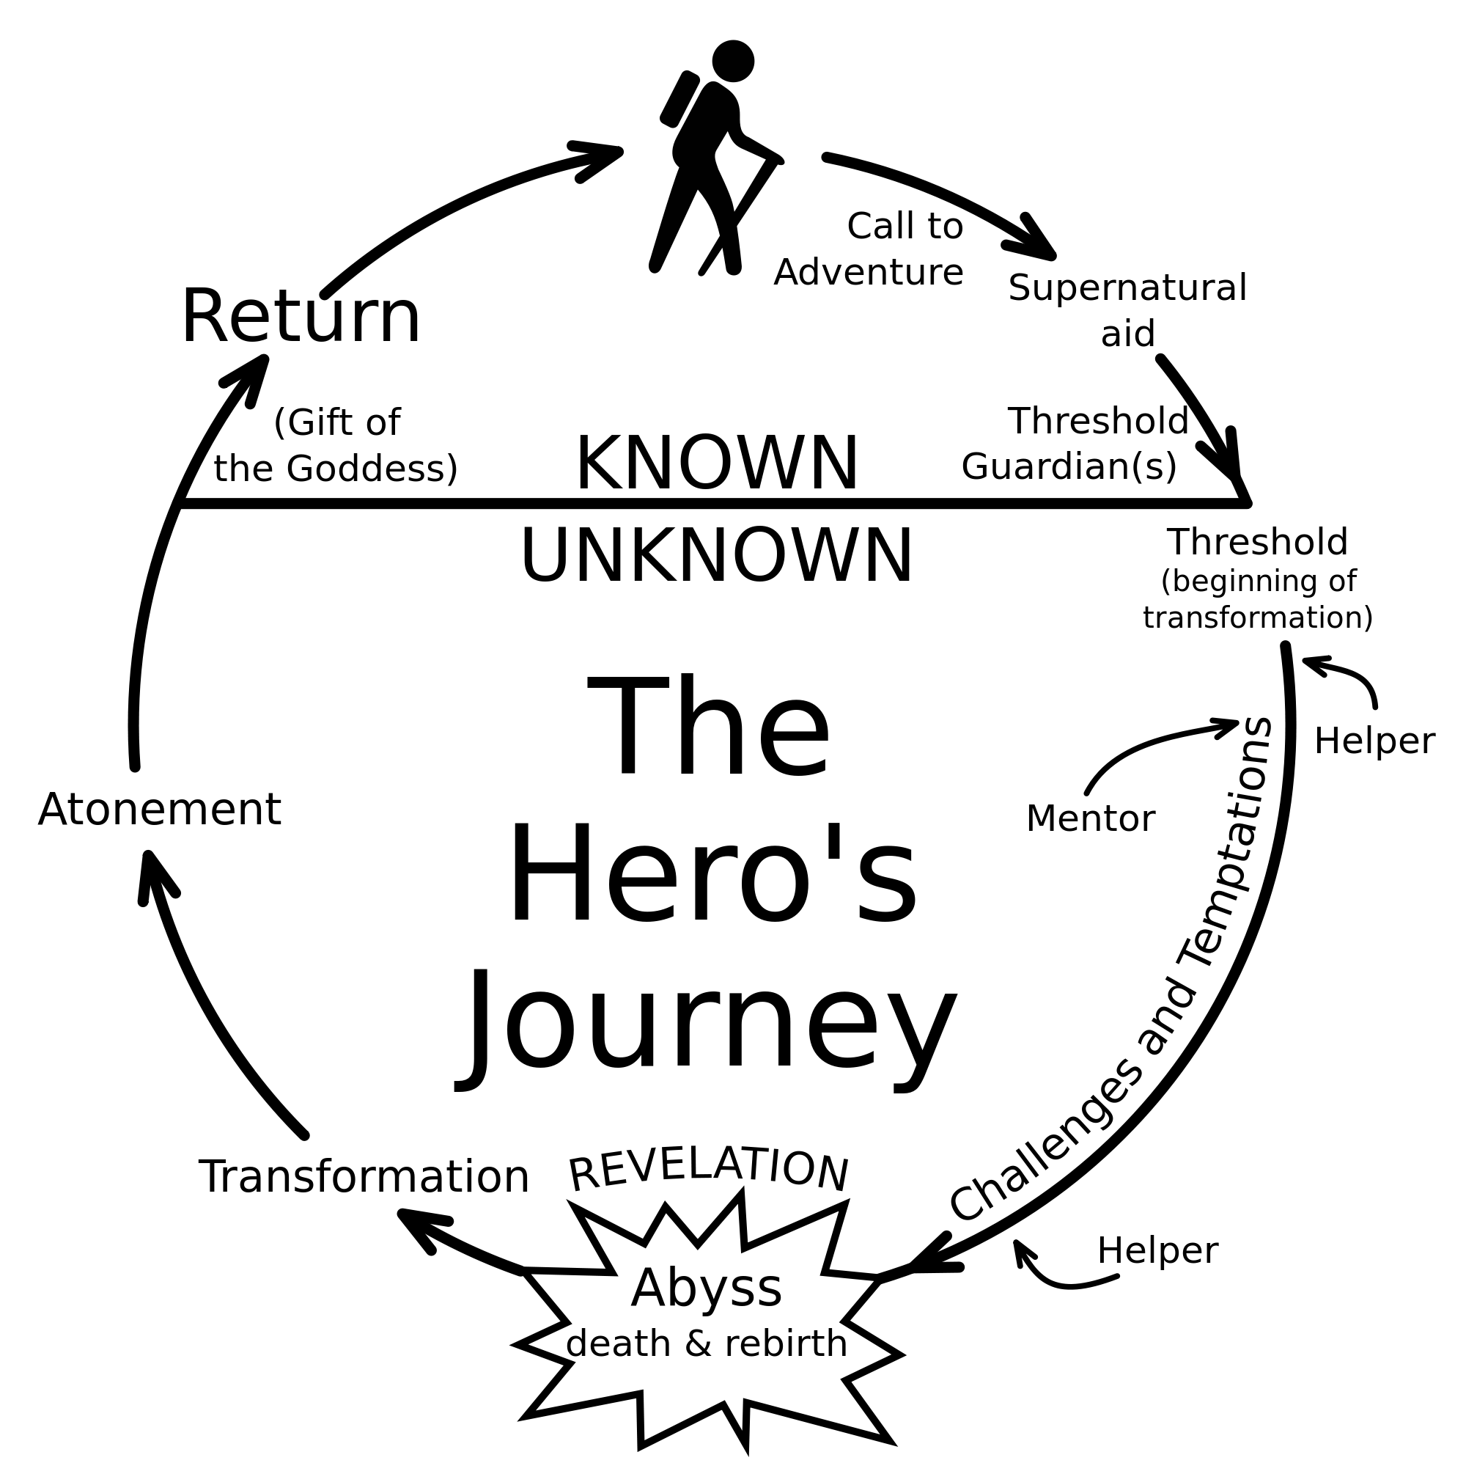
Ways to get to the point

Slide 14
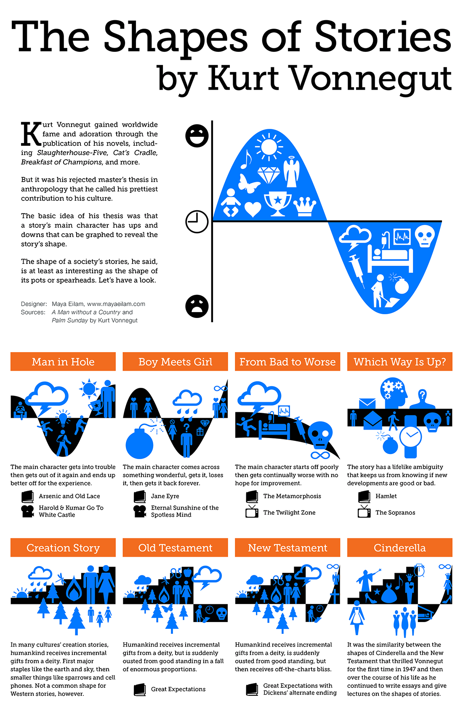
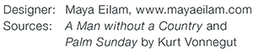
Ways to get to the point (according to Vonnegut)
Notes:
Author of Slaughterhouse 5

Slide 15





Slide 16





Slide 17
Touches people
Characters change through experience
And a bunch of other stuff, too…
What makes a good story?
storyteller
Has substance
Makes people laugh
Has good characters
Representative of the human condition
Embraces idiosyncrasies
Relatable
Have something non-trivial at stake
point
audience
Honest
Must arrive somewhere
Outer struggle
Makes people cry
Imaginable setting
Creates vivid images
Plot structure
Inner struggle
Goes beyond the five senses
Doesn’t default to an easy solution

Slide 18
Storytelling with visualization

Slide 19
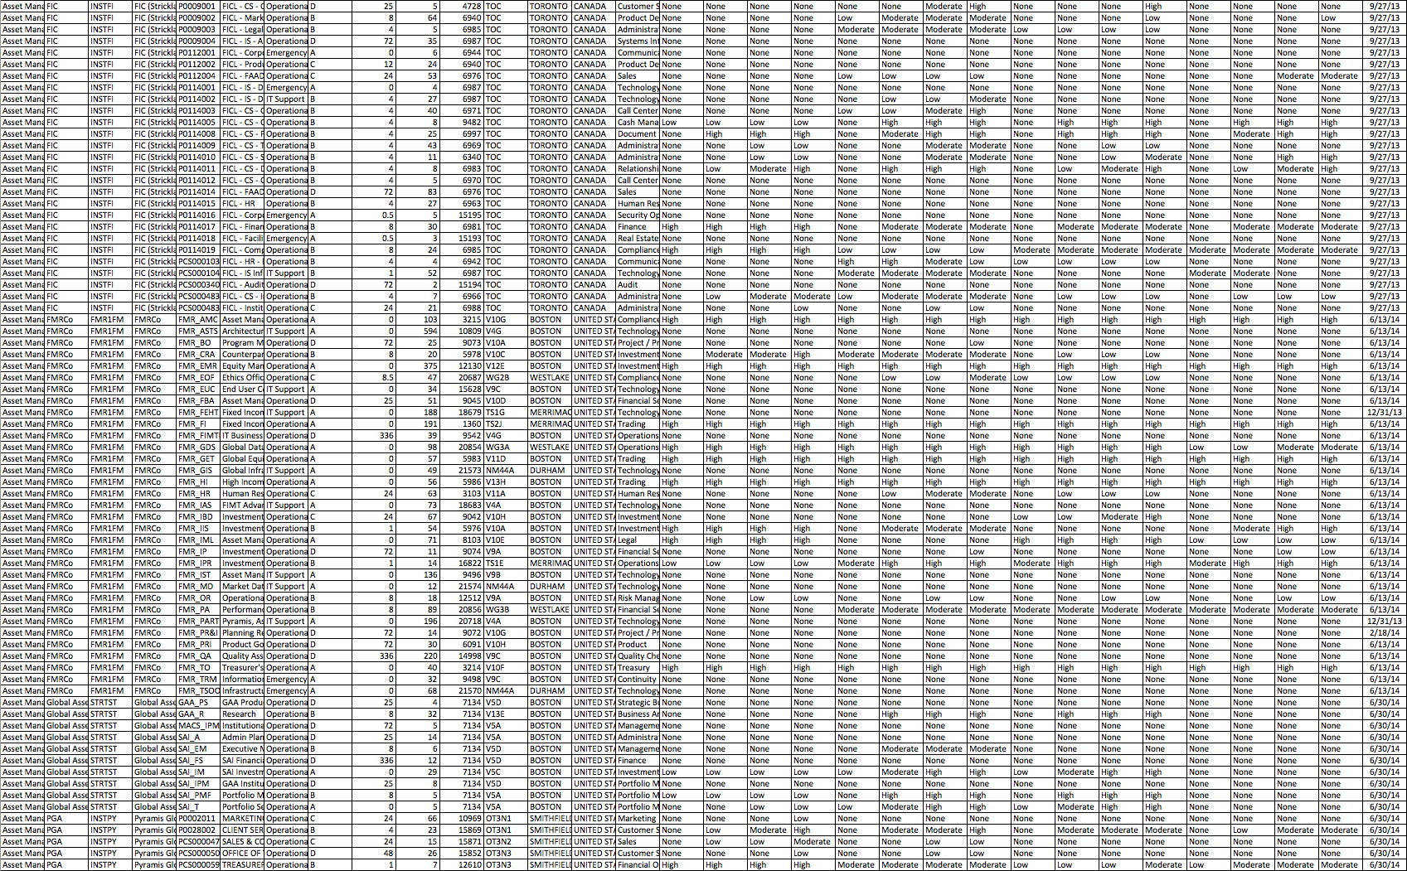
What makes a good data story?
Discussion

Slide 20

Napoleon’s March
“Figurative Map of the successive losses in men of the French Army in the Russian campaign 1812-1813.”
Drawn by Mr. Charles Minard, Inspector General of Bridges and Roads in retirement. Paris, 20 November 1869.

Slide 21
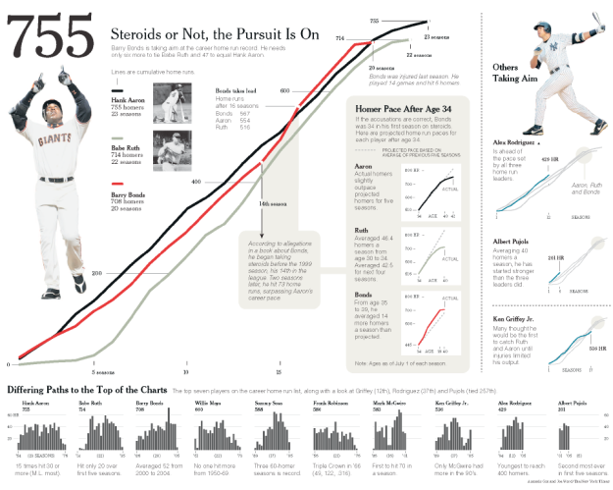
Baseball

Slide 22

Wealth inequality in the US (animated)
https://youtu.be/QPKKQnijnsM?si=j_hPOOsIxFGkNgHM

Slide 23

Wealth inequality in the US (interactive)
https://www.npr.org/sections/money/2015/02/11/384988128/the-fall-and-rise-of-u-s-inequality-in-2-graphs

Slide 24
Telling stories in Tableau
Lab 6
Find instructions for today’s lab on the course website

